Slide 1
Vegetable Market Analysis
Prepared by:
Brajesh V Kulkarni
Shivanni Shinde
Sourabh Wabale
Somya Gupta

Slide 2
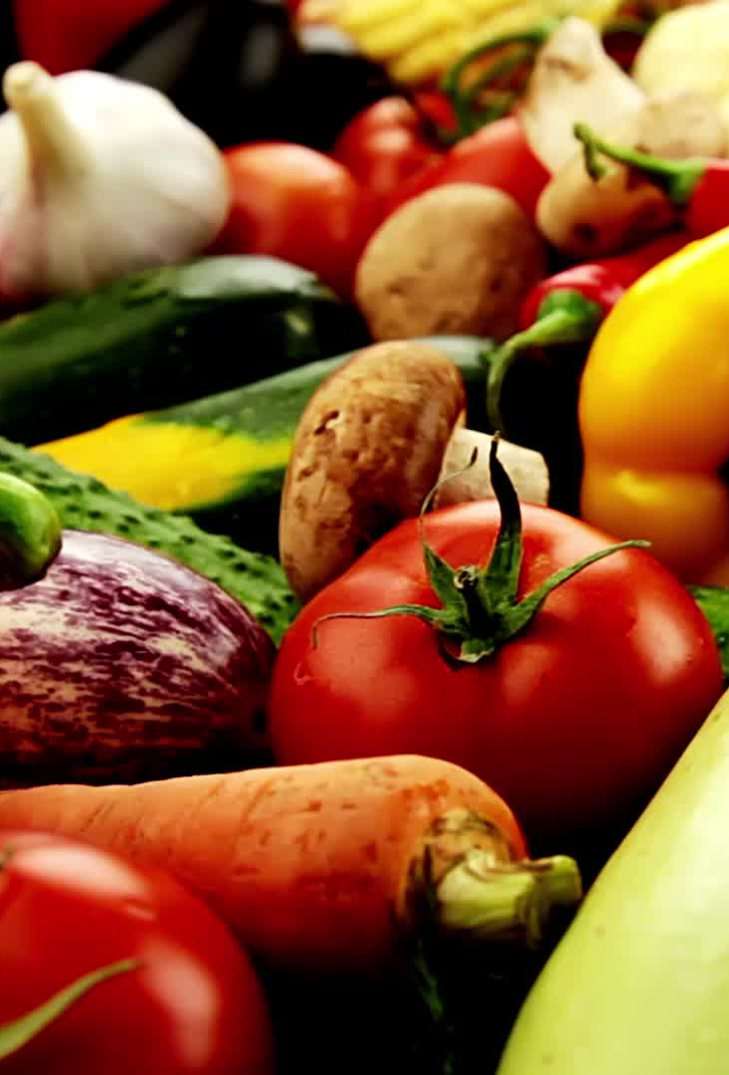
Introduction
Comprehensive Analysis: Our team has conducted an extensive analysis of the Noida vegetable market, covering various aspects to provide a holistic view.
Price Insights: We delved into the market's pricing dynamics by examining average monthly prices and comparing them with neighboring markets.
Seasonal Trends: Our research also focused on understanding which vegetables are in season, helping both buyers and sellers make informed decisions.
Income Groups: We explored how different income groups are affected by vegetable prices, shedding light on affordability and accessibility.
Technology Integration: The use of the Selenium library in Python showcased our commitment to efficient data extraction from online sources, ensuring accurate and up-to-date information.
Market Exploration: Our case study goes beyond the surface, providing insights into market size, potential, competition, key challenges, success factors, and the transformative role of technology in enhancing operations and customer experiences. Additionally, we offer a fresh perspective on the quick commerce vegetable business in Delhi, highlighting its significance in the evolving market landscape.

Slide 3
Objectives
Our first step is to gather comprehensive and trustworthy data from relevant websites, forming the foundation of our vegetable market analysis.
We conduct a thorough examination of the Noida vegetable market, scrutinizing price trends and variations to offer valuable insights into market dynamics.
Through price analysis, we identify which vegetables are in season, aiding consumers and vendors in making well-informed choices.

Slide 4
"THE AVERAGE MONTHLY PRICE OF VEGETABLES IN THE NOIDA MARKET"
Analyzing the average price of each vegetable each month is a valuable aspect of your vegetable market analysis project.
Price Trends: The analysis revealed pronounced price fluctuations throughout the year, driven primarily by seasonal factors.
Stability in Some Vegetables: Certain vegetables maintained relatively stable prices year-round, suggesting consistent availability and affordability for consumers.

Slide 5
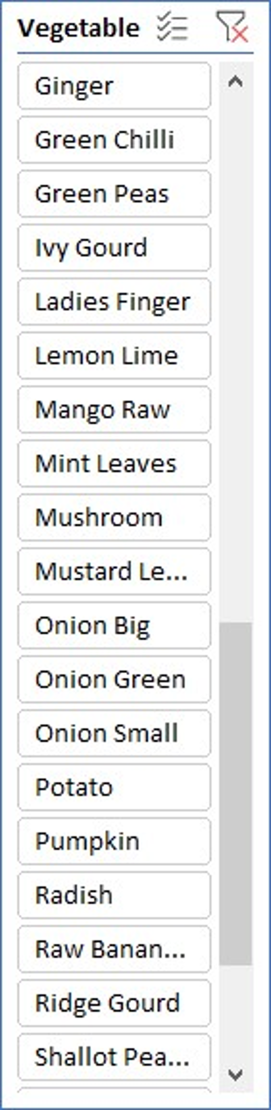
DIFFERENCES OR SIMILARITIES IN THE PRICES OF VEGETABLES IN NOIDA AND NEARBY MARKET
Noida consistently offers lower prices for most vegetables, making it a cost-effective option.
The price difference highlights the potential for significant savings in Noida.
Factors such as proximity to agricultural regions and market competition contribute to the lower prices.
Noida's lower prices provide opportunities for affordability and improved profit margins.

Slide 6
SEASONAL VEGETABLES BY OBSERVING THE FLUCTUATIONS IN PRICE ON DIFFERENT TIME PERIODS
The chart illustrates the price fluctuations of different seasonal vegetables over time.
It showcases the variations in prices during different months or seasons throughout the year.
The fluctuations in vegetable prices can be influenced by external factors such as weather conditions, season, location , and market demand.
The chart reveals correlations between price movements and vegetables season.

Slide 7
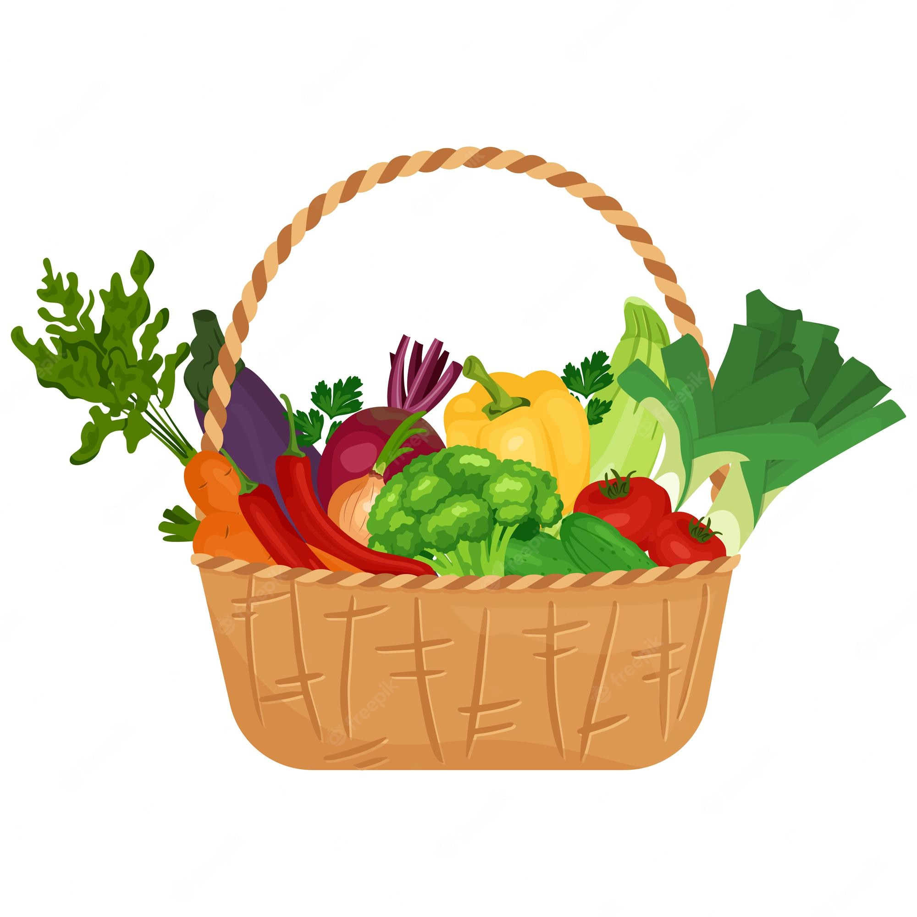
"VEGETABLE BASKET EXPENDITURE BY INCOME GROUP"
Middle income
Low Income :
Sorrel Leaves
Beetroot
Shallot peral
Colocasia Leaves
Garlic
Onion
Potato
Green chillies
Garlic
Onion
Potato
Green chillies
Ash gourd
Clustered beans
Baby corn
French beans
Total - 242
Total - 306
High Income
Garlic
Onion
Potato
Green chillies
Green Peas
Mango Raw
Drumsticks
Mushroom
Total - 451

Slide 8
CHANGE IN BASKET PRICE OF DIFFERENT INCOME GROUPS OVER TIME
The price trend in the Higher income group can be seen more as compared to the middle and lower income groups which shows that the prices of the higher income basket fluctuated

Slide 9
INFLATION RATE FOR EACH INCOME GROUP"
Findings From Charts
Low-Income Impact: A significant decrease in inflation from -13% in low-income areas suggests that vegetable prices have decreased substantially, making essential vegetables more affordable for low-income households.
Middle-Income Stability: Although still negative at -4%, the inflation rate in middle-income areas has shown some improvement compared to the previous year. This indicates a potential stabilization in vegetable prices, which could benefit middle-income families.
Higher-Income Trends: In higher-income areas, the inflation rate decreased to -2%. While this suggests that vegetable prices have decreased slightly, the impact on higher-income households may be less pronounced due to their greater purchasing power.
Overall Market Trends: The overall decrease in vegetable prices across income groups indicates a potential improvement in the vegetable market's stability and affordability. However, it's essential to monitor whether these trends continue over time to provide sustained relief to consumers.

Slide 10
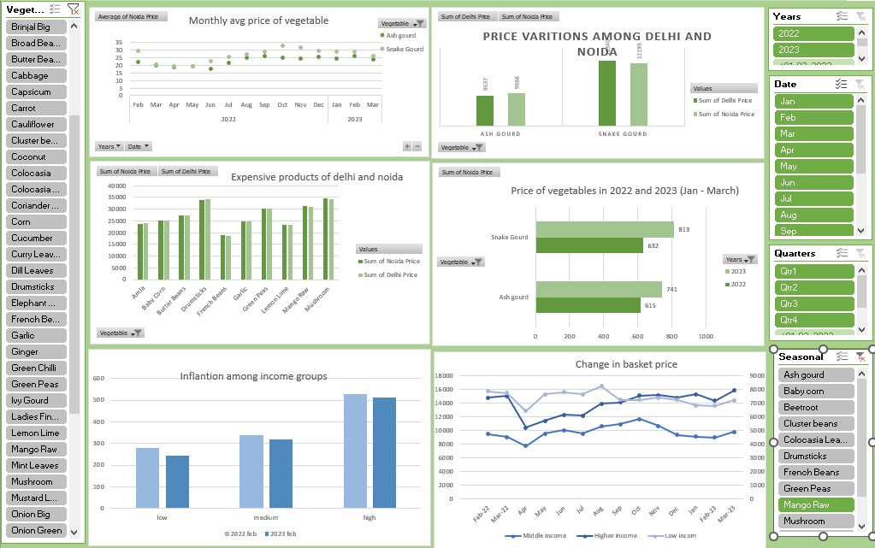
Vegetable market price Analysis

Slide 11
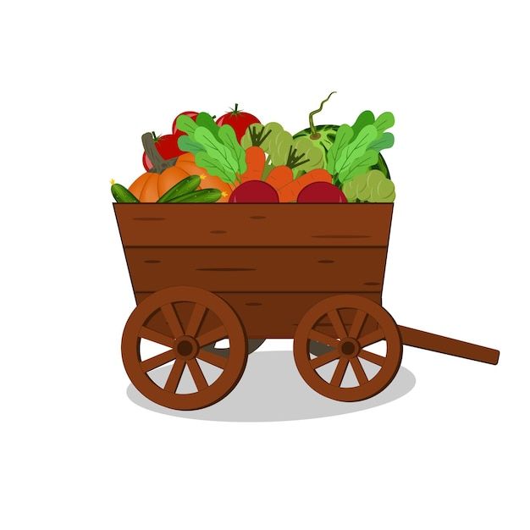
Case Study on Quick Commerce Vegetable Business in Delhi:

Slide 12

Market Size and Potential for Quick Commerce Vegetable Business in Delhi:
Delhi's Quick Commerce Vegetable Business is booming because more people in the city want quick and fresh vegetable deliveries.
There's a lot of competition and some challenges with delivering on time and maintaining quality.
But there's a chance for this business to get bigger because people in Delhi like different things and investors are interested.
It's important to follow the rules and work with partners to succeed.
The future looks good because more people are moving to cities and how they shop for vegetables is changing.

Slide 13

Competitive landscape for quick commerce vegetable business in Delhi:
There are lots of companies doing the same thing - delivering vegetables quickly.
Some big companies are in the game, like big grocery stores and online giants.
Many smaller, local businesses are also competing, sometimes with unique offerings.
Competition often leads to price wars, which can be good for consumers.
Companies are trying to stand out by offering better quality and fresher vegetables.
Quick delivery is a big focus to win over customers.
Some companies use loyalty programs to keep customers coming back.
There's a lot of innovation happening, like using technology to improve services.
Despite the competition, maintaining good service and keeping prices low can be tough.
With more people in Delhi and changing shopping habits, there's still room for new players to enter the market.

Slide 14
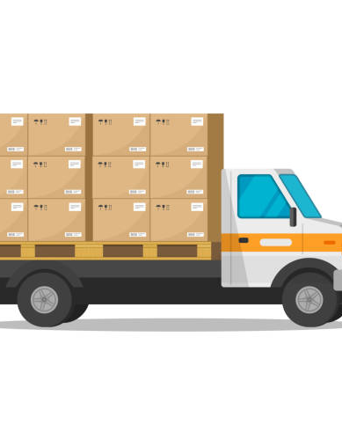
Key challenges faced by the quick commerce vegetable business in Delhi
Delivery Delays: Traffic and logistics can cause delays in getting vegetables to customers quickly.
Quality Control: Ensuring that vegetables stay fresh during delivery can be a challenge.
Competition: Many businesses are fighting to attract the same customers.
Price Pressure: Trying to keep prices low while maintaining quality can be tough.
Customer Expectations: Customers expect on-time delivery and high-quality produce.
Logistics Costs: Handling transportation and delivery expenses can eat into profits.
Seasonal Variations: The availability and cost of vegetables change with the seasons, affecting business.
Regulatory Compliance: Adhering to food safety and delivery regulations is crucial but can be complex.
Supply Chain Issues: Ensuring a steady supply of fresh vegetables can be challenging.
Tech Investments: Keeping up with technology for efficient operations can be costly.

Slide 15

KEY SUCCESS FACTORS
Quality and Freshness: Providing high-quality and fresh vegetables is essential for customer satisfaction and building a good reputation.
Price Competitiveness: Offering competitive prices relative to market standards ensures affordability and attracts price-conscious consumers.
Efficient Supply Chain: An efficient supply chain with reliable sources of vegetables, effective distribution, and minimal wastage is crucial for maintaining consistent product availability and reducing costs.
Customer Service and Convenience: Offering excellent customer service, convenient ordering options, and on-time deliveries can build strong customer loyalty and drive repeat business.

Slide 16

CONCLUSION
The vegetable market analysis in Noida unveiled price trends and income group preferences, underlining the need for tailored strategies addressing affordability and diverse consumer needs.
Furthermore, it showcased the significant potential for quick commerce vegetable businesses in Delhi, fueled by the demand for convenient delivery services in the urban environment.
In essence, the project's findings illuminated market dynamics and stressed the importance of adaptability to evolving consumer behaviors in Delhi's vegetable market.

Slide 17

THANK YOU
We express our gratitude to our project sponsors for their trust in our abilities, our dedicated team members for their hard work in conducting the analysis, our mentors and guides for their invaluable support throughout the project, everyone in attendance today for their time and attention, and the Selenium library in Python for streamlining data extraction and analysis, which significantly contributed to our project's success.

